Slide 1
Anglian Water
WAT-07366
Gayton, Water Treatment Works
Gayton Parish Council
Umar Hafeez – Project Manager
Adam Ford - Technical Manager
Thomas Say- Customer Co-ordinator
Date: 21st Sep 2021

Slide 2



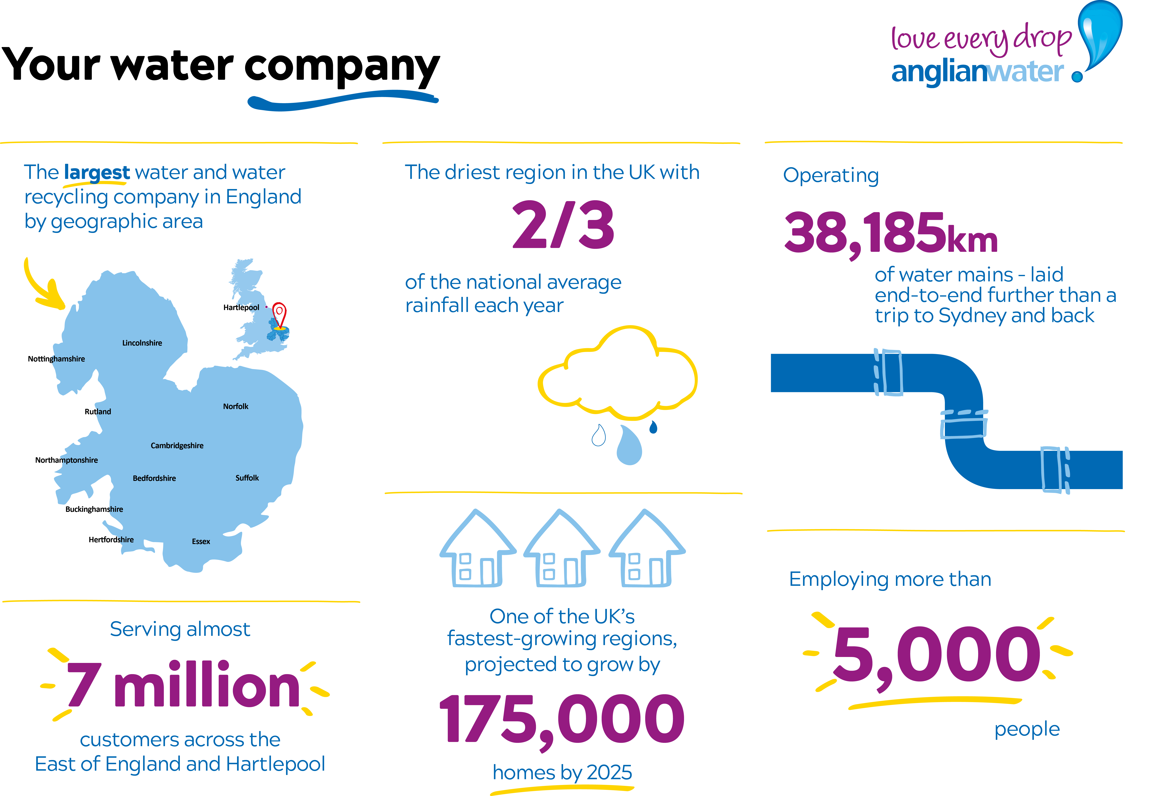








Our region, purpose and strategic direction
Our Purpose is to bring environmental and social prosperity to the region we serve through our commitment to Love Every Drop
Our strategic direction
Make the East of England resilient to the risks of drought and flooding​
Enable sustainable economic and housing growth in the UK’s fastest-growing region​
Be a net zero carbon business by 2030​
Work with others to achieve significant improvement in ecological quality across our catchments

Slide 3



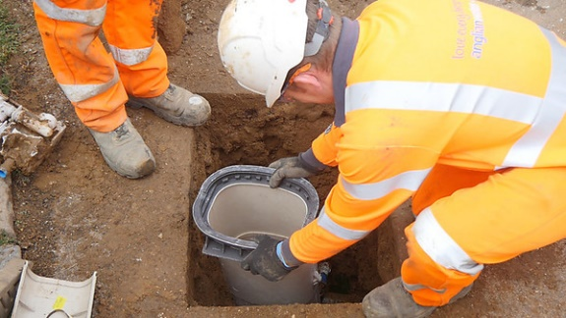
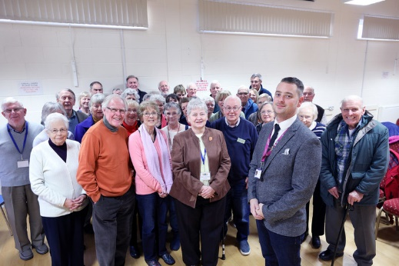
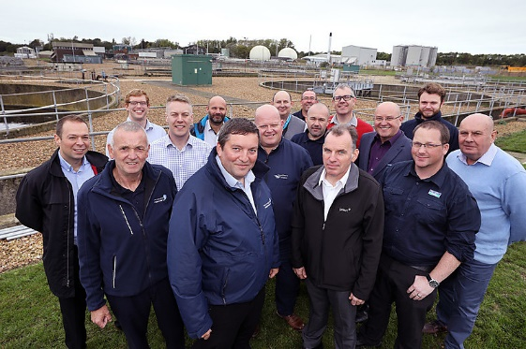
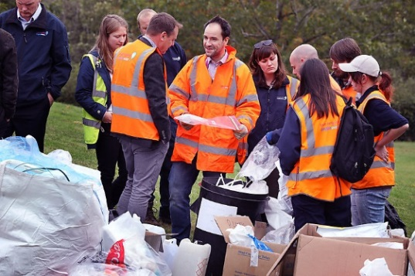
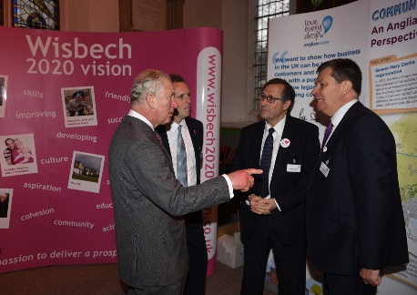
Project Background & solution
The driver for the project is to remove nitrate from the raw water at Gayton Water Treatment Plant.
Nitrates are a natural compound of nitrogen and oxygen. Nitrate in water mainly results from intensive farming when farmers boost productivity by adding fertilisers. Nitrate can enter groundwater and can result in a raw, untreated water resource with an unacceptable nitrate level.
Currently, the Gayton Water Treatment plant abstracts raw water from the two boreholes on site. This water is then treated to meet the UK drinking water standard before being supplied to customers.
Proposed Solution
Installation of nitrate plant.

Slide 4
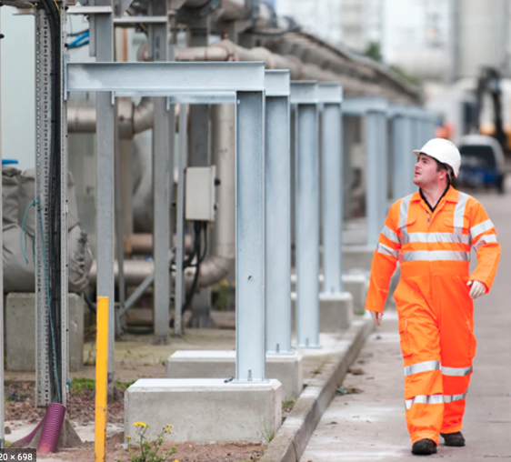
Project Details
Cost : Approx. £3.4 million investment
Dates : Approx. 18 months
Construction start : Q4 2022
DWI date : Dec 2023

Slide 5
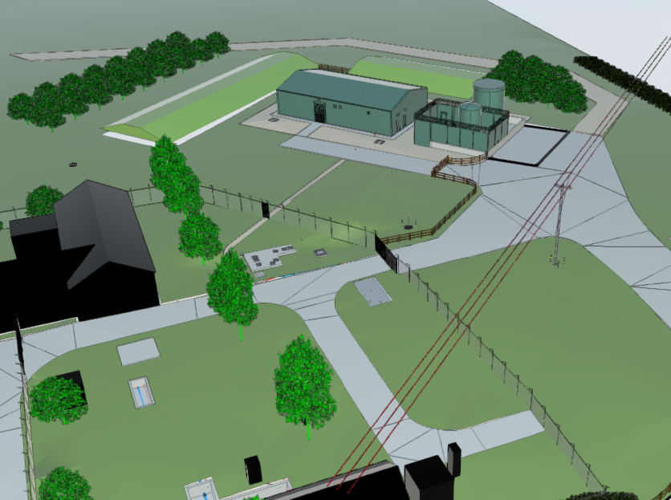
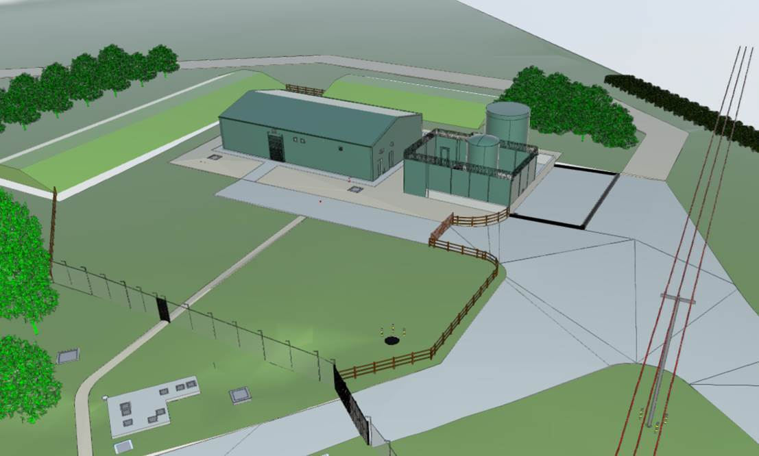
3D model of the proposed new nitrate plant

Slide 6


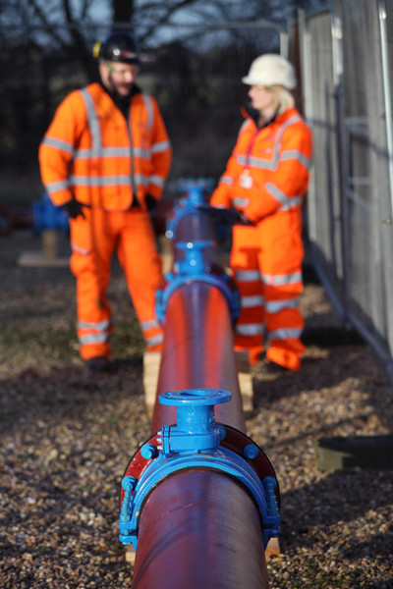
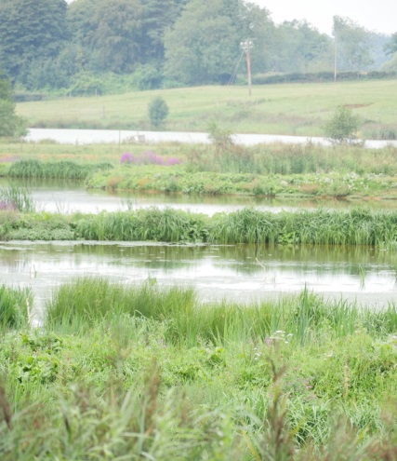
Working with you in mind
In determining the work we carry out, we consider several criteria, including the potential impact on local communities, impacts on the environment such as on protected and sensitive wildlife sites and technical factors, including the complexity and cost of the construction.

Slide 7
Working with you in mind
Positioning the new buildings and tanks away from the existing boreholes to protect the existing aquifer and supply.
Position the new building to remove the need to move the 11kVA power lines and reduce disruption to nearby properties.
Construct a timber post and rail fence rather than a 3m height security fence for a more aesthetically pleasing finish.
Locating the development away from residential properties .
Ensuring that vehicles and deliveries take an alternative route by developing the existing access to the field.
The majority of our work will take place within our normal working hours and typically on weekdays.

Slide 8
Our current position
Optimise the layout - less materials used, lower carbon footprint, reduced construction activity.
Planning has not yet been submitted.
Ground investigation has taken place on site. We need to establish the geology of the ground; helping us choose suitable design and construction techniques.
Ecology, tree survey, topographical survey complete.
Discussions ongoing on increase in net biodiversity.

Slide 9

Keeping you informed
Hand delivered letter drops- opportunity for residents to talk directly to the team.
LPA pre application to be started.
Ongoing communication and commitment.
Pre-commencement letters- detailing the work and letting residents know what they can expect
Update letters- as the work progresses.
We will communicate if anything changes.
1-2-1 (Covid dependant) door knocks to customers if requested for greater detail.
Regular updates via our “In Your Area” website
Surveys for feedback and learning.

Slide 10

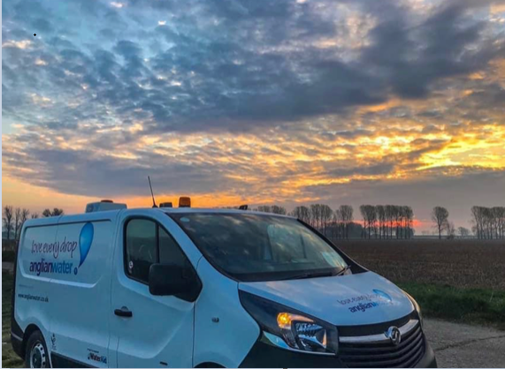

Image here

